Slide 1
Inheritance

Slide 2
Mr. M.R. Solanki
Sr. Lecturer, Information Technology,
manish_ratilal2002@yahoo.com
SBMP

Slide 3
Learning Outcomes
Students will be able to:
Design and Develop Inheritance related real world problems.
Execute programs related to runtime polymorphism.
Use interface to achieve multiple inheritance.

Slide 4
Inheritance

Slide 5
Inheritance Definition
A class inherits qualities from its parent and it is also having its own qualities.
Using inheritance, we can create a general class that defines traits (characteristics/attributes) common to a set of related items.
This class can then be inherited by other, more specific classes, each adding those things that are unique to it.
In the terminology of Java, a class that is inherited is called a superclass. The class that does the inheriting is called a subclass.

Slide 6
A subclass is a specialized version of a superclass. It inherits all of the members defined by the superclass and adds its own, unique members.

Slide 7
Access Specifiers
Java’s access modifiers are public, private, and protected. Java also defines a default access level.
protected applies only when inheritance is involved.
When a member of a class is specified as public, then that member can be accessed by any other code.
Note: main( ) has always been preceded by the public modifier because It is called by code that is outside the program—by the Java run-time system.

Slide 8
Access Specifiers
When a member of a class is specified as private, then that member can only be accessed by other default/public member methods of its class.
When no access modifier is used, then by default the member of a class is public within its own package(directory), but cannot be accessed outside of its package.

Slide 9
Single Level Inheritance

Slide 10
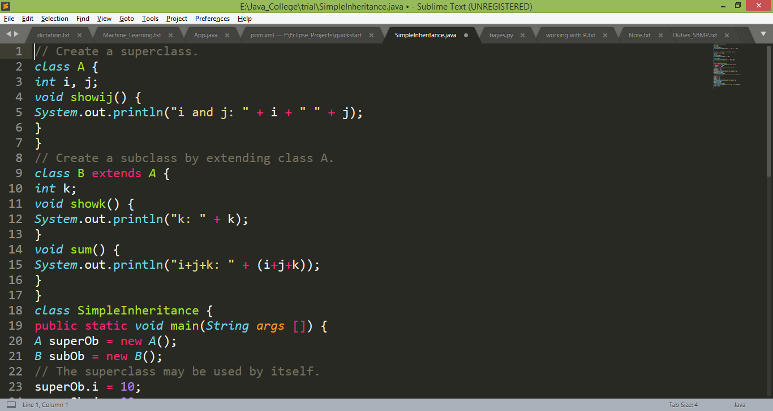
Inheritance Basics
To achieve Inheritance, we have to use extends keyword

Slide 11
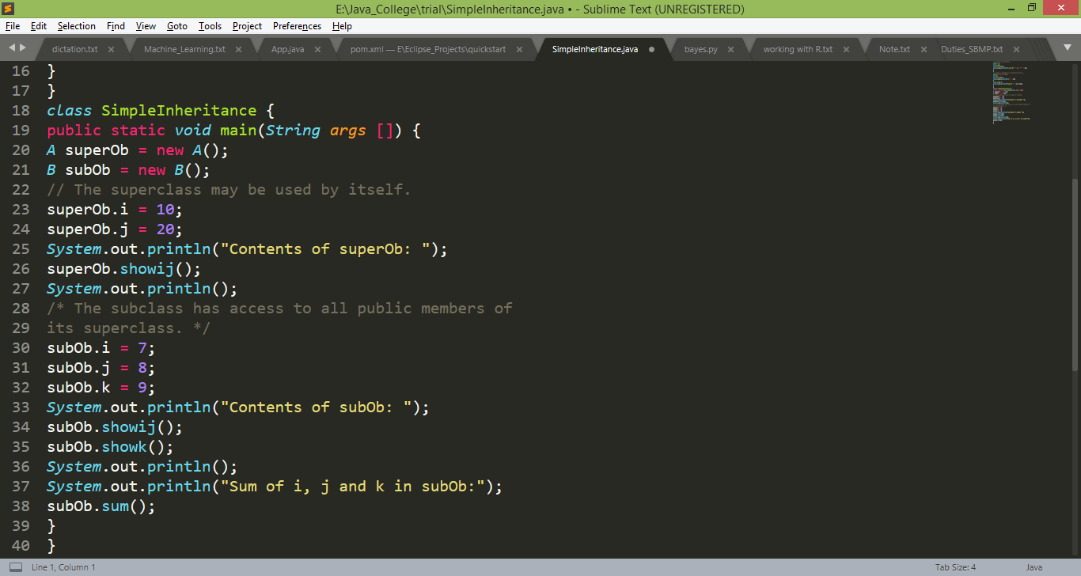
Inheritance Basics

Slide 12
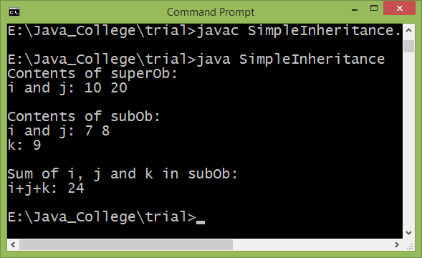
Inheritance Output

Slide 13
Example
Consider class “Box” (we used in earlier chapters) Another class “BoxWeight” inherits Box and having unique properties i.e. weight.
Write an application to test the functionality of given hierarchy of classes

Slide 14
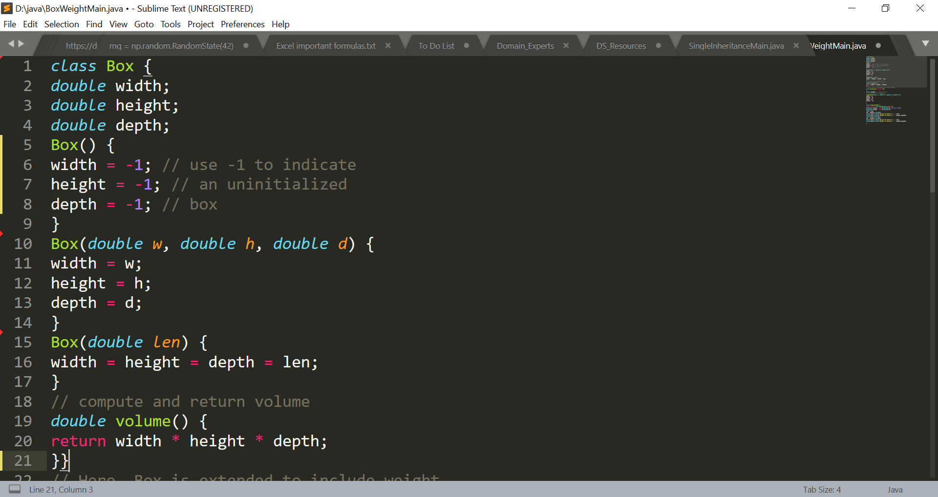
Single Level Inheritance

Slide 15
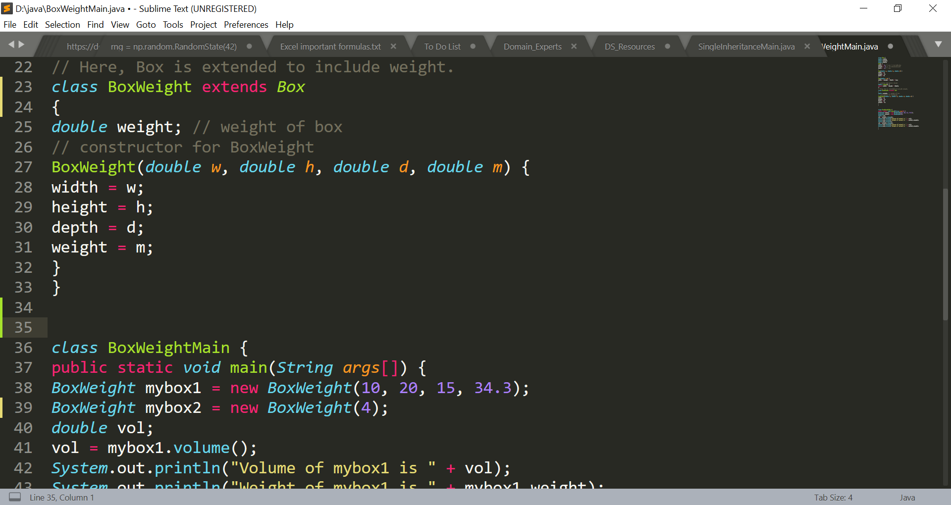
Single Level Inheritance

Slide 16
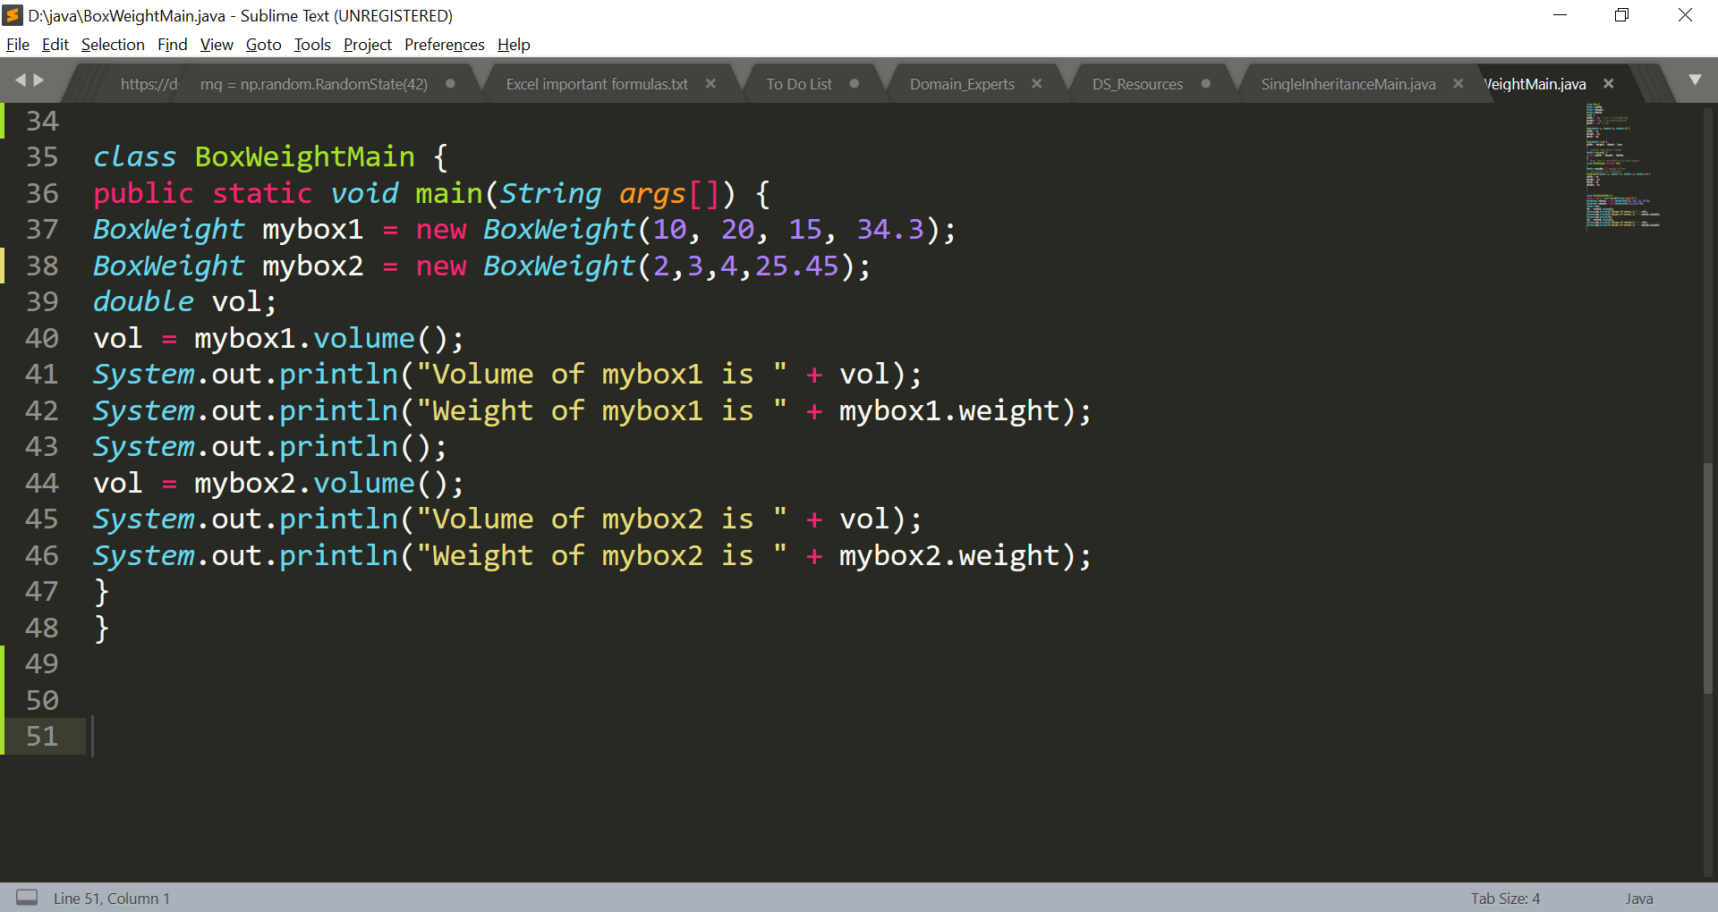
Single Level Inheritance

Slide 17

Single Level Inheritance

Slide 18
Exercise
Define a class “Shape” having two data members i.e. dim1 and dim2. Another class “Rectangle” inherits Shape and having unique property i.e. area which stores area of a rectangle.
Write an application to test the functionality of given hierarchy of classes.

Slide 19
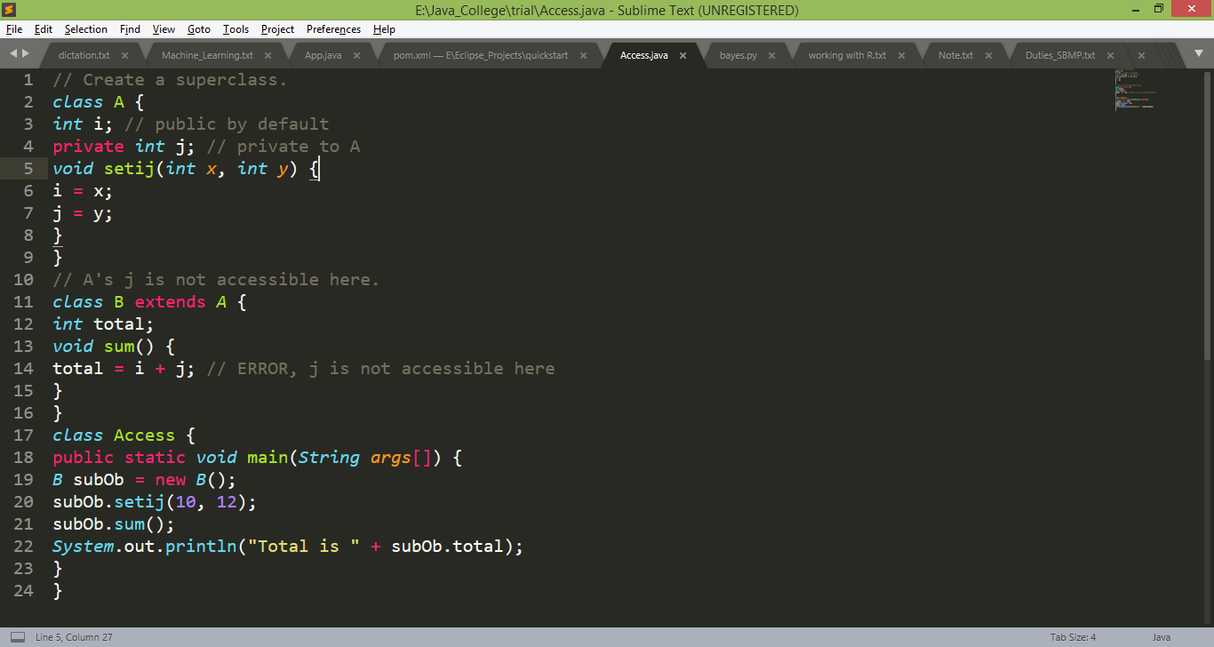
Member Access & Inheritance
Although a subclass includes all of the members of its superclass, it cannot access private members of superclass.

Slide 20
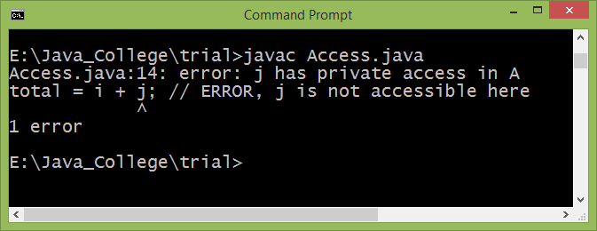
Member Access & Inheritance
private member access error

Slide 21
Need of super keyword
The constructor for BoxWeight explicitly initializes the width, height, and depth fields which leads duplication of code in Box and BoxWeight class.
If super class declares its members as private then subclass can not access it.
Solution:
Whenever a subclass needs to refer to its immediate superclass, it can use super keyword.
super has two general forms:
To call the superclass’ constructor
To access super class member in case of name duplication.

Slide 22
super to Call Superclass Constructors
A subclass constructor can call a super class constructor using super as follows:
super(arg-list);
Here, arg-list specifies any arguments needed by the constructor in the superclass.
super( ) must always be the first statement executed inside a subclass’ constructor.

Slide 23
super to Call Superclass Constructors
improved version of the BoxWeight class:
class BoxWeight extends Box {
double weight;
BoxWeight(double w, double h, double d, double m)
{
super(w, h, d); // call superclass constructor
weight = m;
}
}

Slide 24
To access Superclass Member
Second use of super is to access the member of super class in subclass.
super.member
Here, member can be either a method or an instance variable.

Slide 25
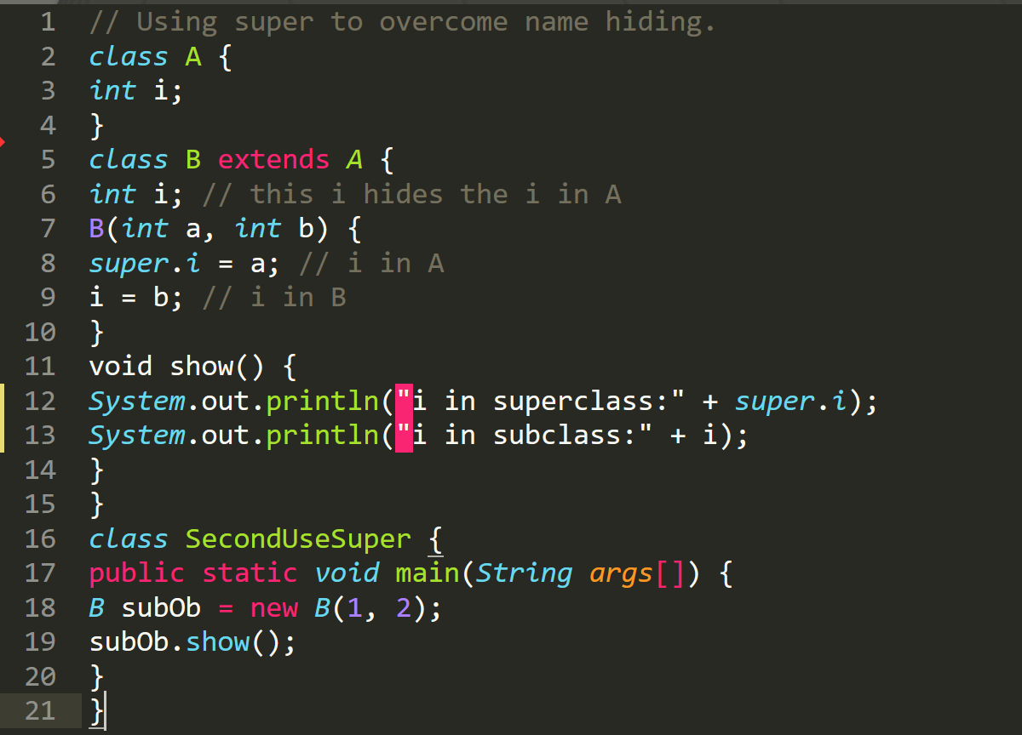
To access Superclass Member

Slide 26
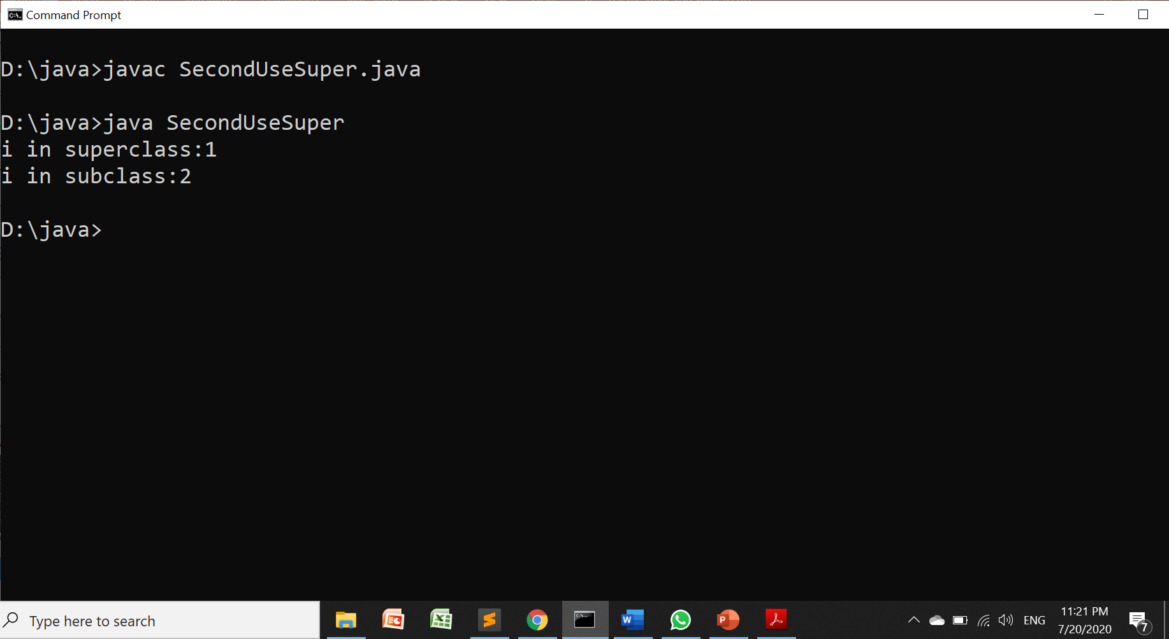
To access Superclass Member

Slide 27
To access Superclass Member

Slide 28
Hierarchical Inheritance

Slide 29
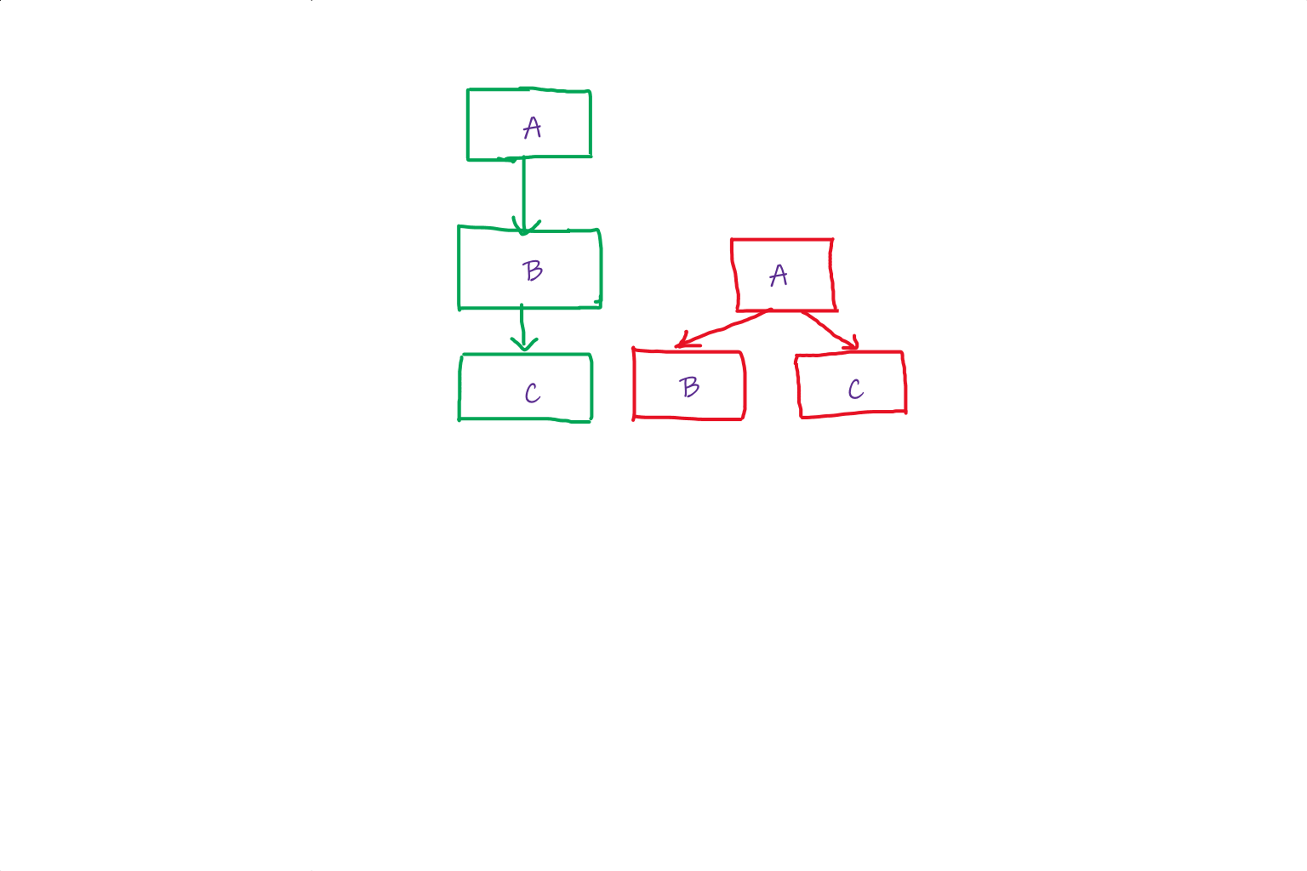
Hierarchical Inheritance
One class is being inherited by more than one class. (a parent is having more than one child)

Slide 30
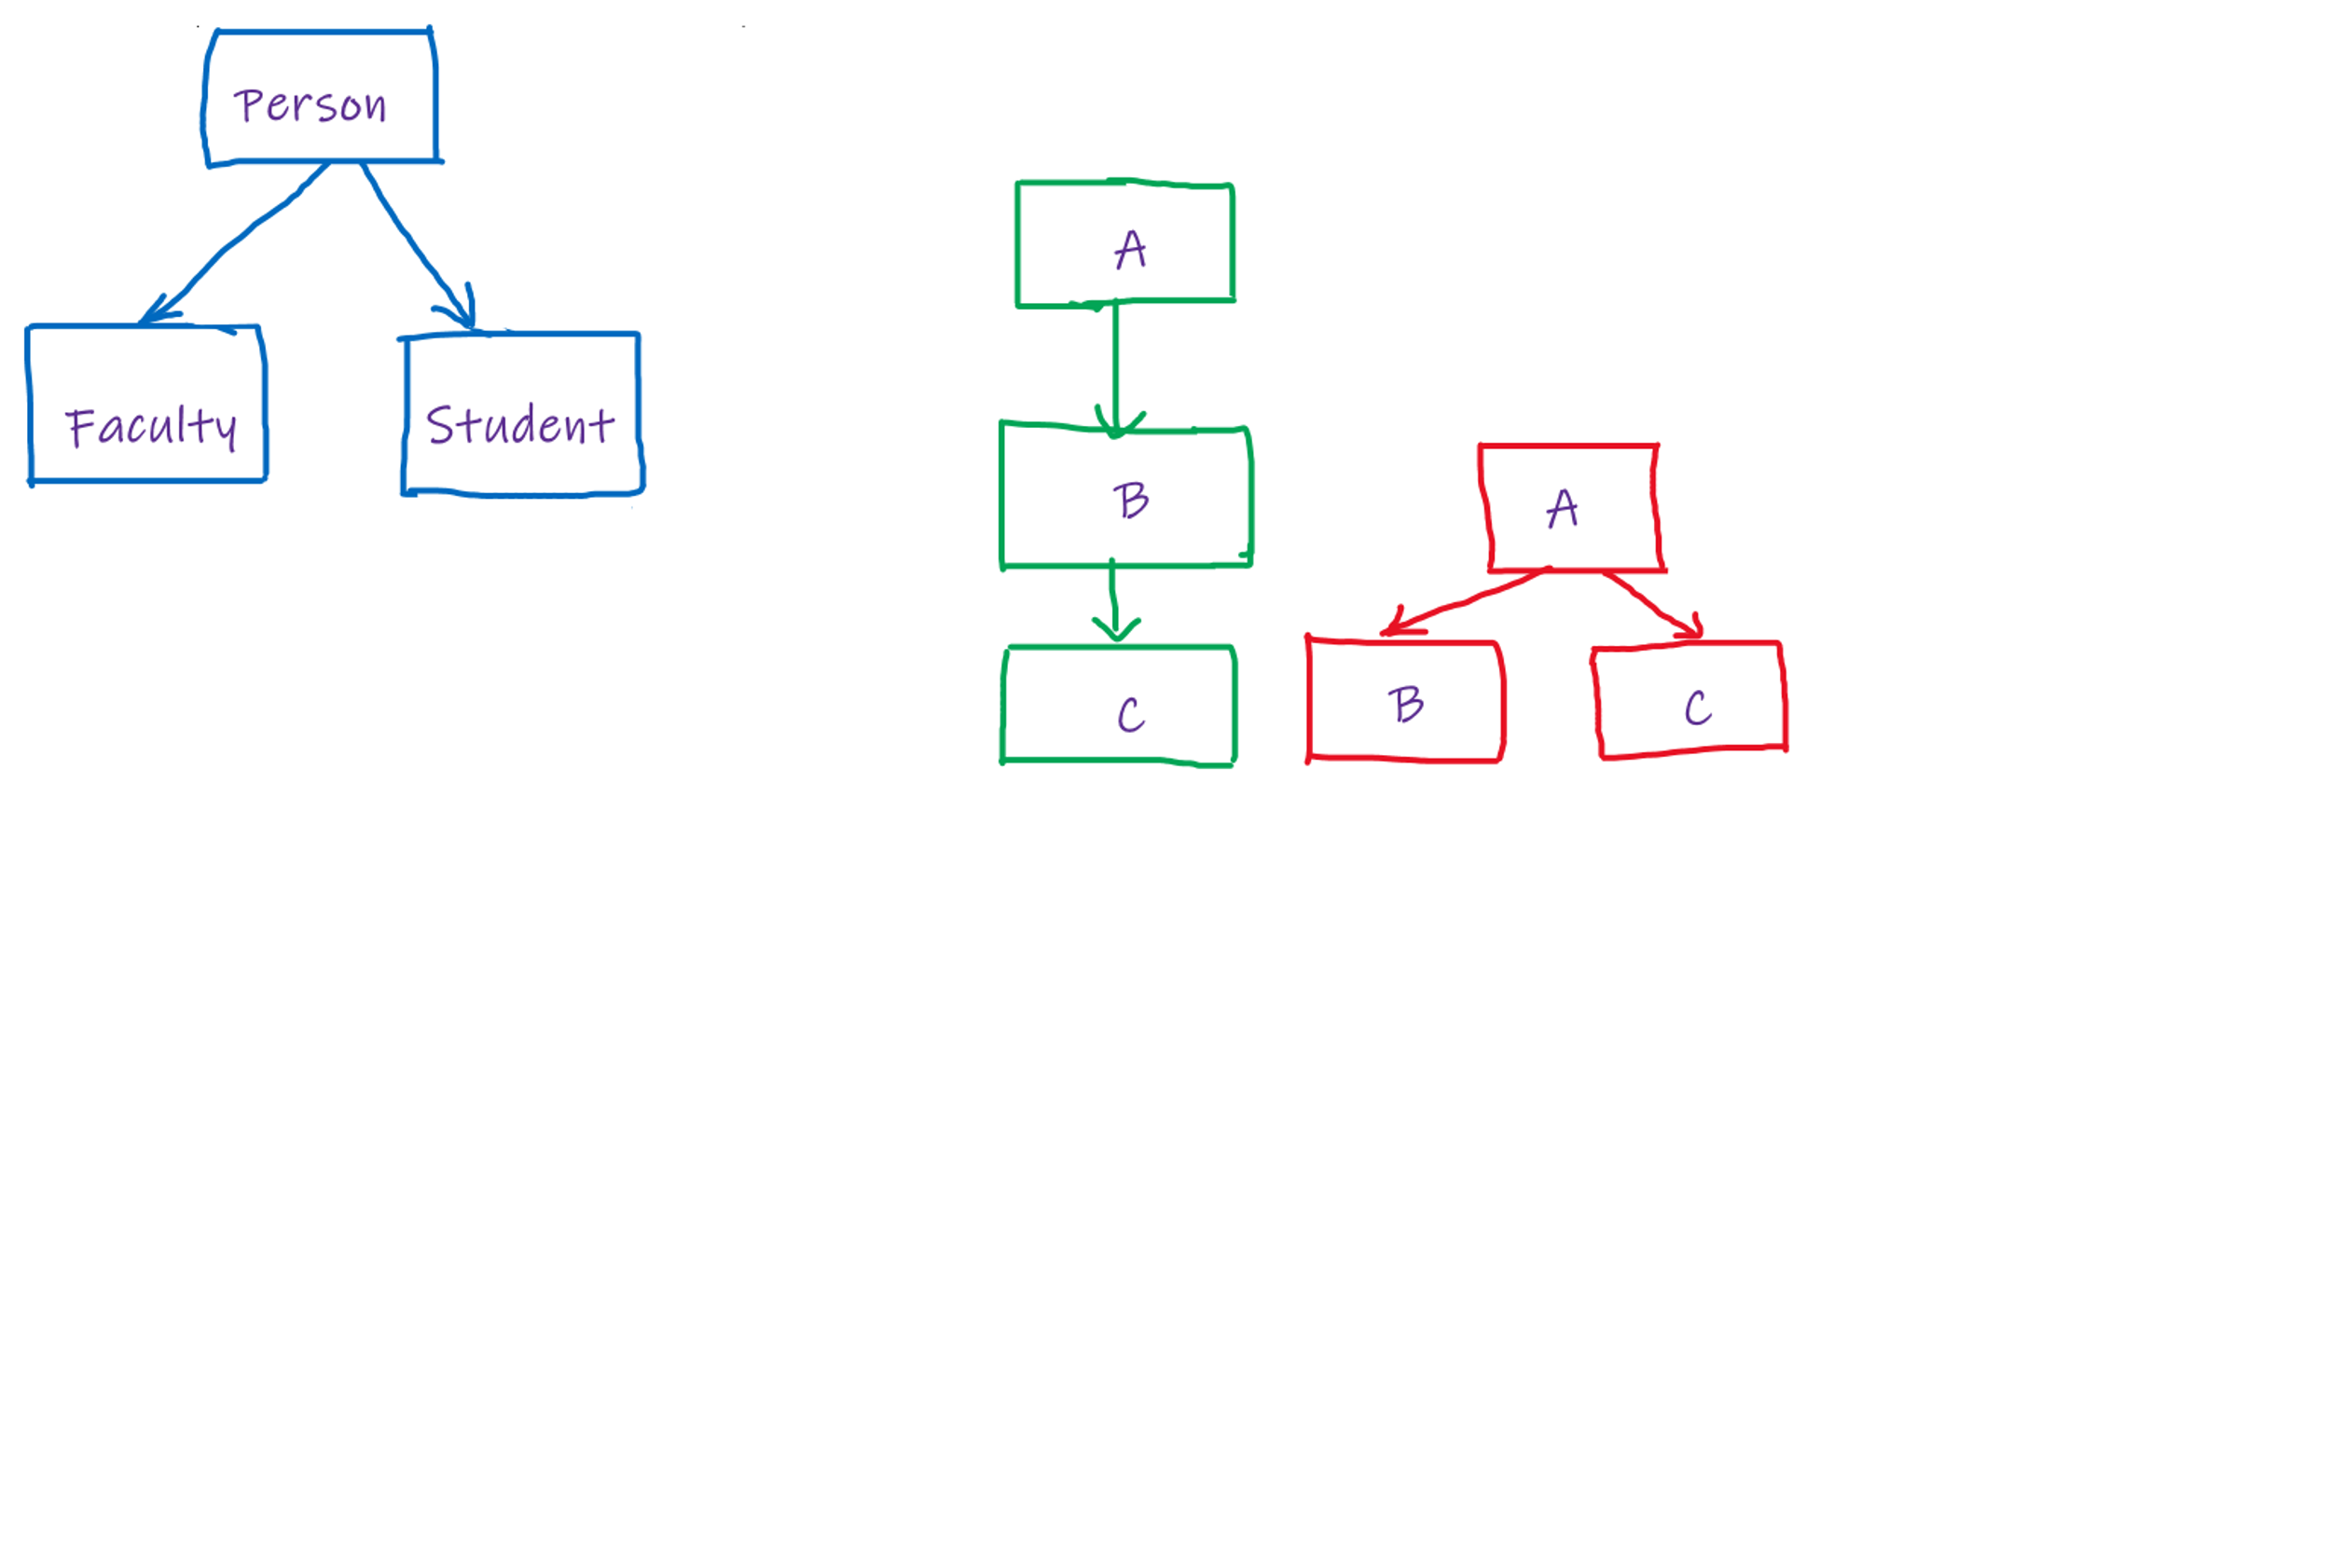
Hierarchical Inheritance
Example/Exercise

Slide 31
Multilevel Inheritance

Slide 32
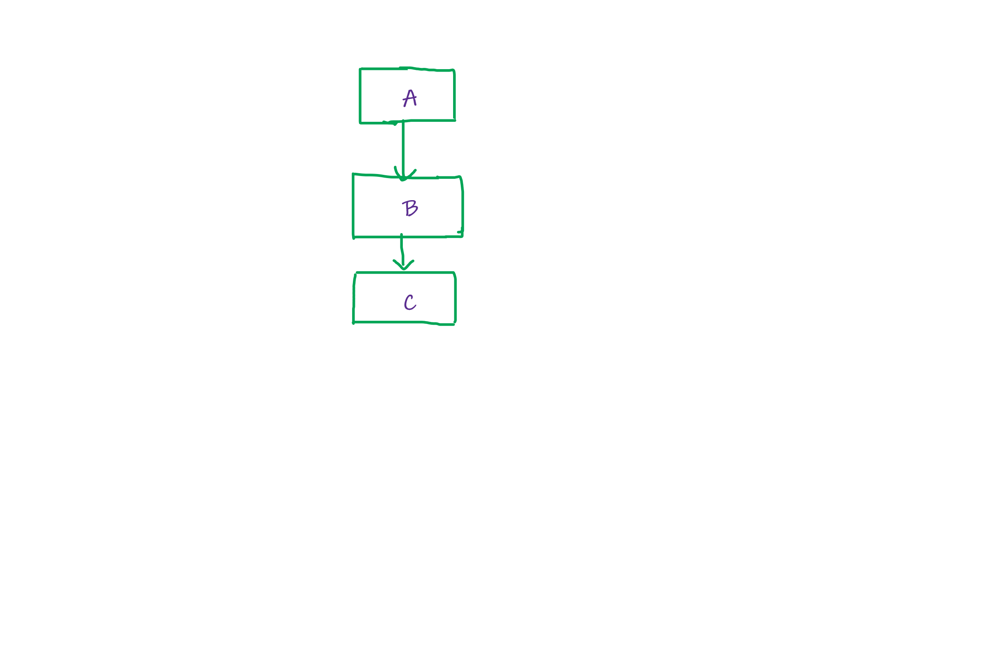
Multilevel Inheritance
One class is being inherited by other class which in turn is being inherited by another class.
Grand Father -> Father -> Grandson hierarchy

Slide 33
Multilevel Inheritance
Example/ Exercise:
Consider the hierarchy of Box->BoxWeight inheritance. A class Shipment is inheriting class BoxWeight and having cost as a data member.
Write a Java application to test the functionality of given classes.

Slide 34
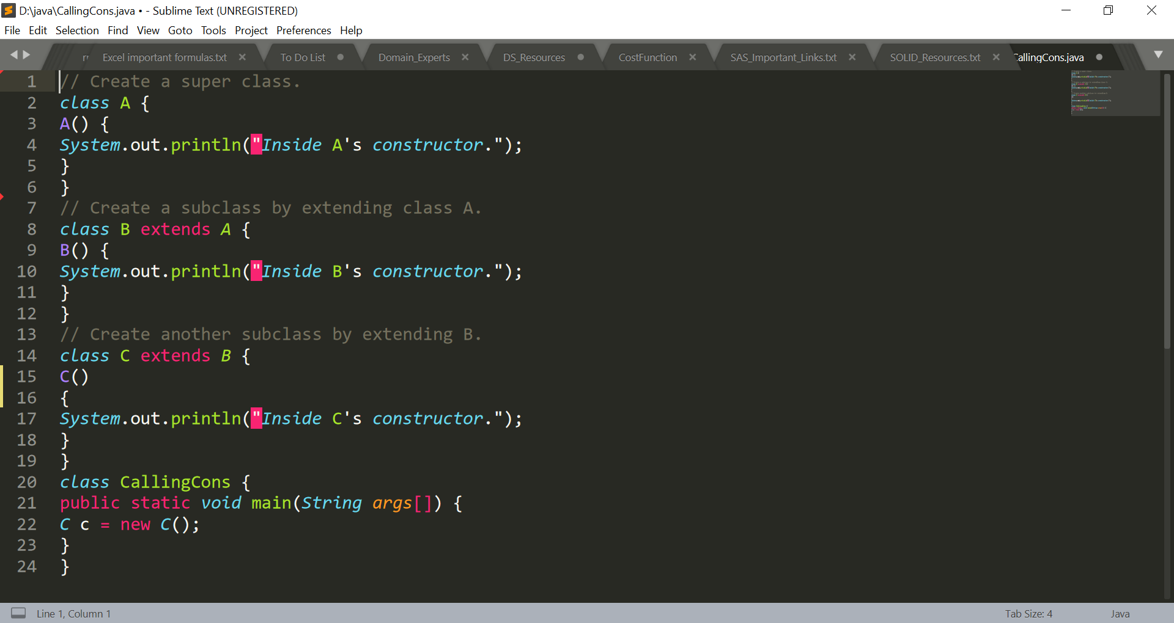
Multilevel Inheritance
Calling Constructors:

Slide 35
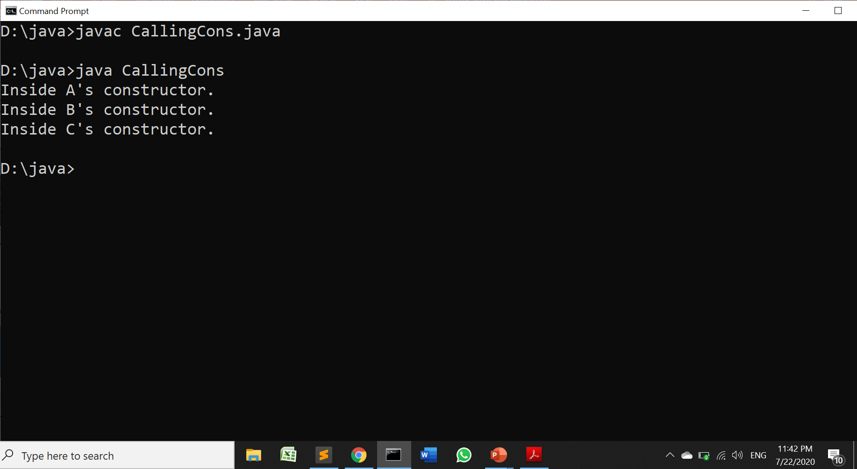
Multilevel Inheritance
Calling Constructors:

Slide 36
Polymorphism

Slide 37
Method Overriding
In a class hierarchy, when a method in a subclass has the same name and type signature as a method in its superclass, then the method in the subclass is said to override the method in the superclass.
When an overridden method is called from within its subclass, it will always refer to the version of subclass. The version of the method defined by the superclass will be hidden.

Slide 38
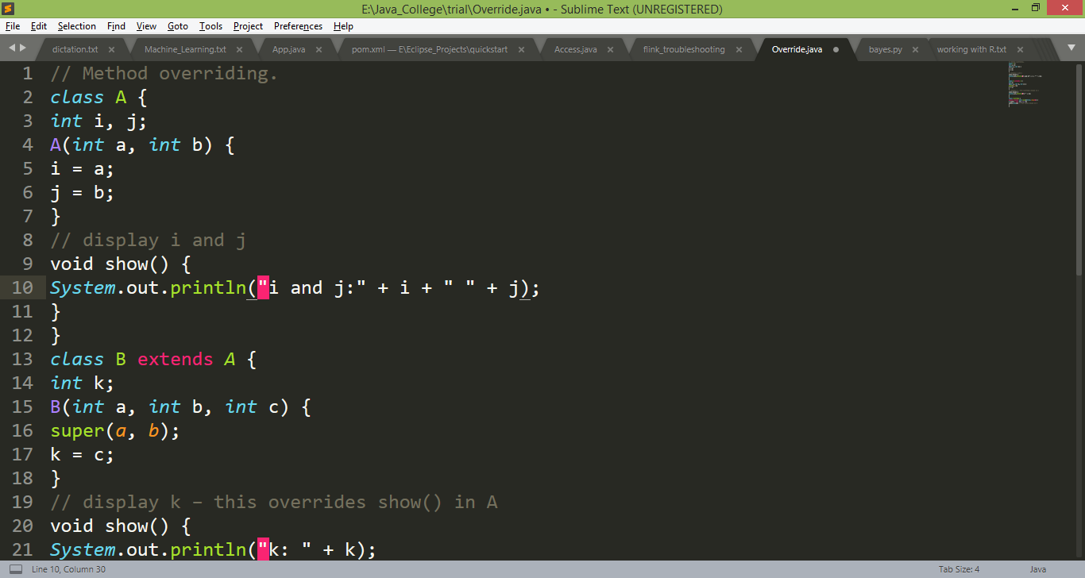
Method Overriding

Slide 39
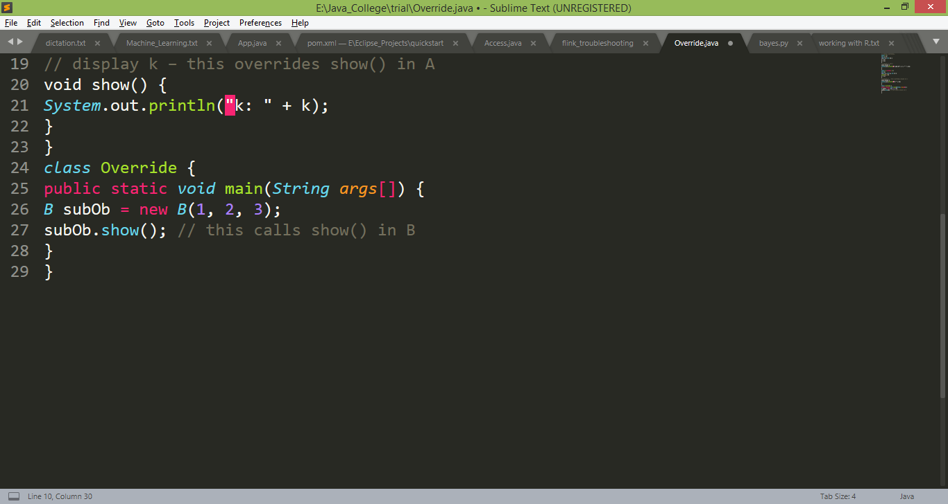
Method Overriding
Output:
k: 3

Slide 40
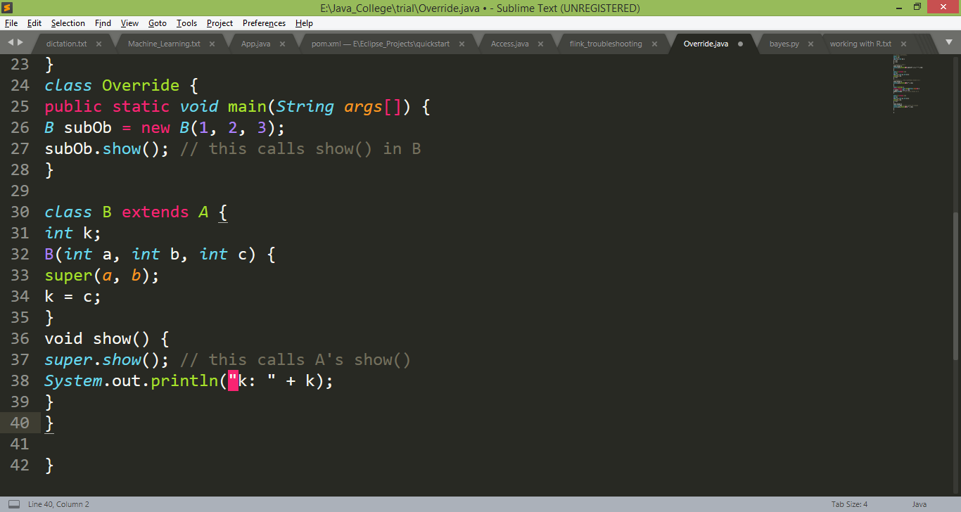
Method Overriding
If you wish to access the superclass version of an overridden method, you can do it by super
Example: in this version of B, the superclass version of show( ) is invoked within the subclass’ version
Output:
i and j: 1 2
k: 3

Slide 41
Method overriding occurs only when the names and the type signatures of the two methods are identical. If they are not, then the two methods are simply overloaded.

Slide 42
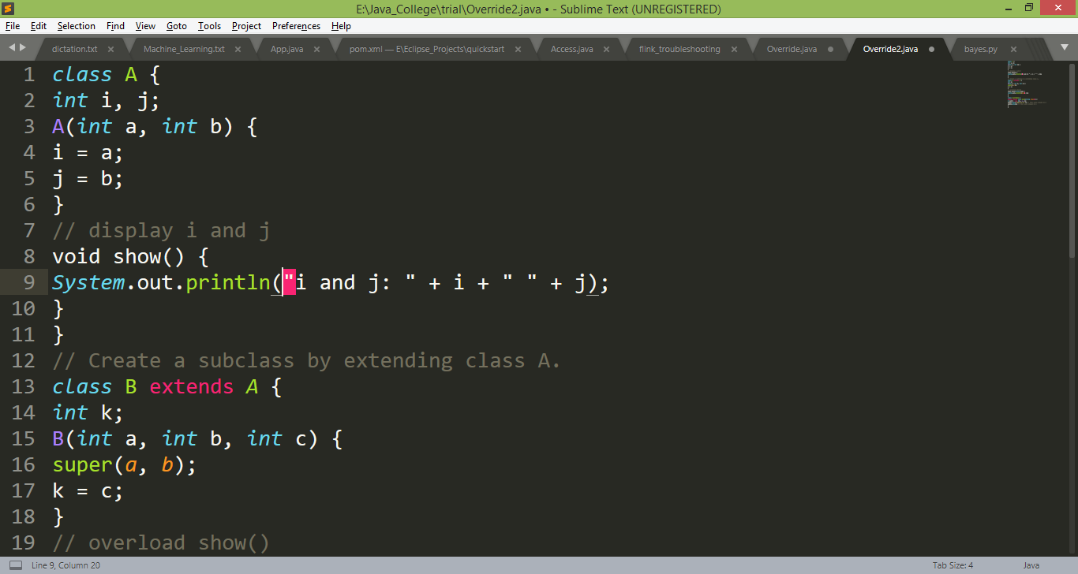
Method Overloading in Inheritance

Slide 43
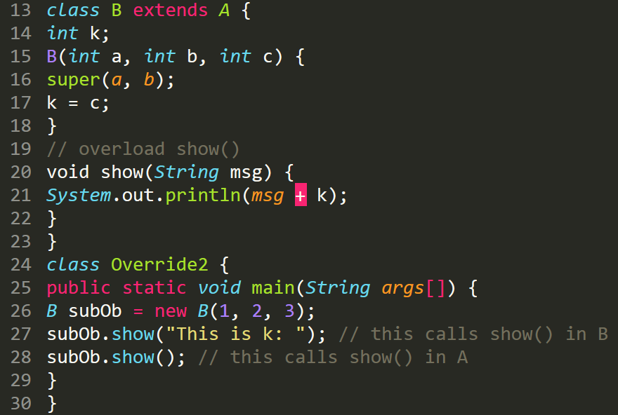
Method Overloading in Inheritance

Slide 44
A reference variable of a superclass can be assigned a reference to any subclass derived from that superclass(A super class reference variable can refer a subclass object)
Box b;
BoxWeight bw =new BoxWeight(2.0f, 3.5f, 4.5f, 10f);
b = bw;
b.volume();

Slide 45
If a super class reference, refers a subclass object it can access only those qualities which a subclass has inherited.
It can not access unique qualities of a sub class.

Slide 46
Dynamic Method Dispatch
Method overriding forms the basis for one of Java’s most powerful concepts: dynamic method dispatch
Dynamic method dispatch is the mechanism by which a call to an overridden method is resolved at run time, rather than compile time
Java uses “A super class reference variable can refer a subclass object” principle to resolve calls to overridden methods at run time

Slide 47
Dynamic Method Dispatch
When an overridden method is called through a superclass reference, Java determines which version of that method to execute based upon the type of the object being referred to at the time the call occurs. Thus, this determination is made at run time
In other words, it is the type of the object being referred to (not the type of the reference variable) that determines which version of an overridden method will be executed.

Slide 48
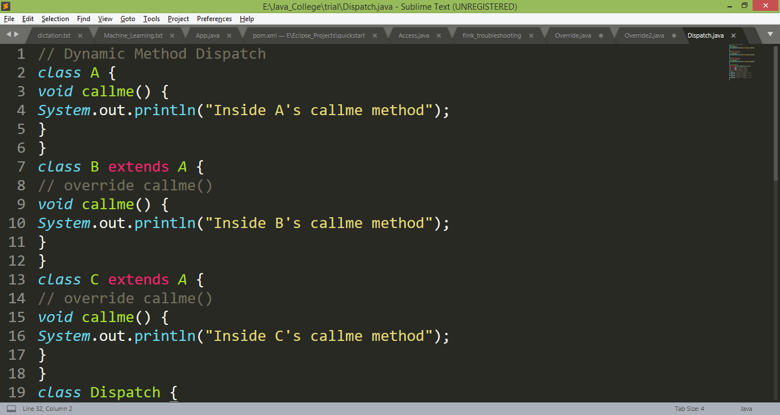
Dynamic Method Dispatch
Example:

Slide 49
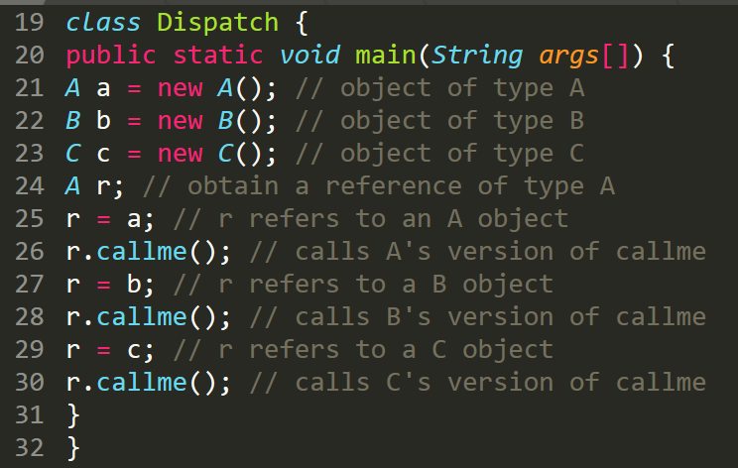
Dynamic Method Dispatch

Slide 50
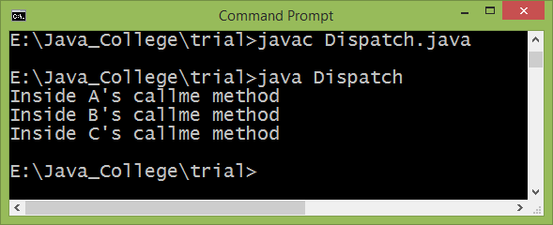
Dynamic Method Dispatch

Slide 51
Applications of Runtime Polymorphism
It allows a general class to specify methods that will be common to all of its derivatives, while allowing subclasses to define the specific implementation of some or all of those methods.
Overridden methods are another way that Java implements the “one interface, multiple methods” aspect of polymorphism.
superclasses and subclasses form a hierarchy which moves from lesser to greater specialization.

Slide 52
Applications of Runtime Polymorphism
Dynamic, run-time polymorphism mechanism provides code reuse and robustness.
The ability of existing code libraries to call methods on instances of new classes without recompilation them.

Slide 53
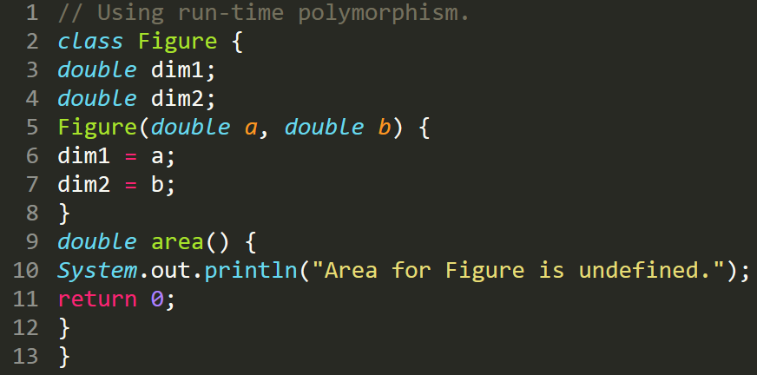
Applying Runtime Polymorphism

Slide 54
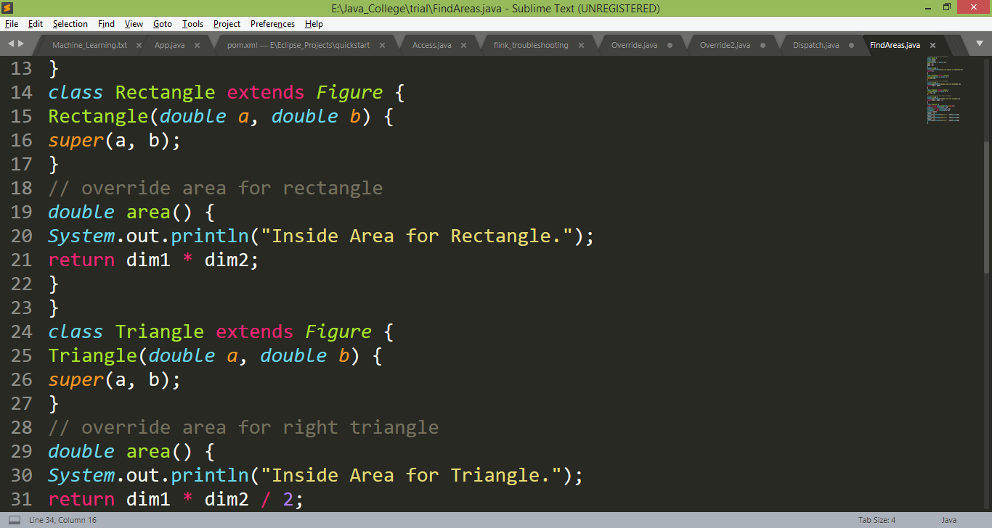
Applying Runtime Polymorphism

Slide 55
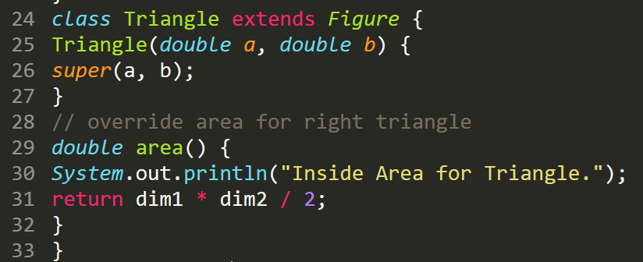
Applying Runtime Polymorphism

Slide 56
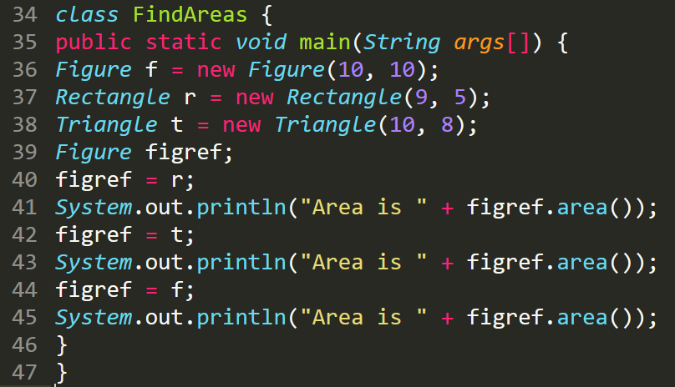
Applying Runtime Polymorphism

Slide 57
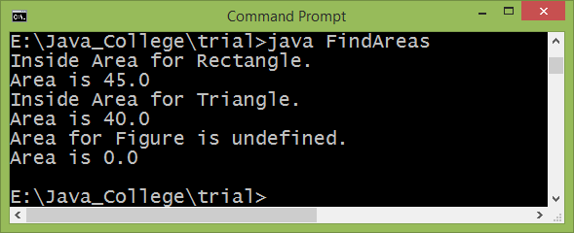
Applying Runtime Polymorphism

Slide 58
Abstract Method
Sometimes a superclass declares the structure of a given abstraction without providing a complete implementation of every method (superclass only defines a generalized form leaving details to be filled by subclass)
Such a class determines the nature of the methods that the subclasses must implement.
Java’s solution to this problem is the abstract method
Such methods are preceded with abstract keyword as shown below:
abstract type name(parameter-list);
These methods are sometimes referred to as subclasser responsibility because they have no implementation specified in the superclass. Thus, a subclass must override them.

Slide 59
Abstract Class
Any class that contains one or more abstract methods must also be declared abstract.
To declare a class abstract, you simply use the abstract keyword in front of the class keyword at the beginning of the class declaration.
There can be no objects of an abstract class. (cannot be directly instantiated with the new operator)
You cannot declare abstract constructors, or abstract static methods.
Any subclass of an abstract class must either implement all of the abstract methods in the superclass, or be declared abstract itself.

Slide 60
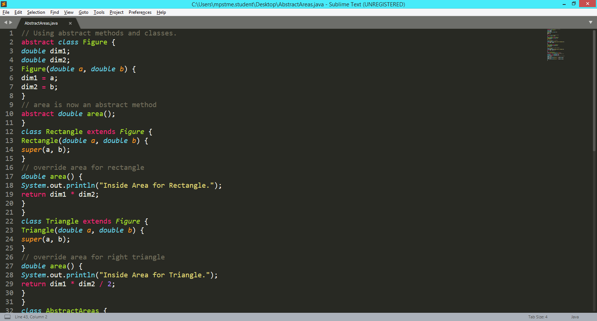
Abstract Example

Slide 61
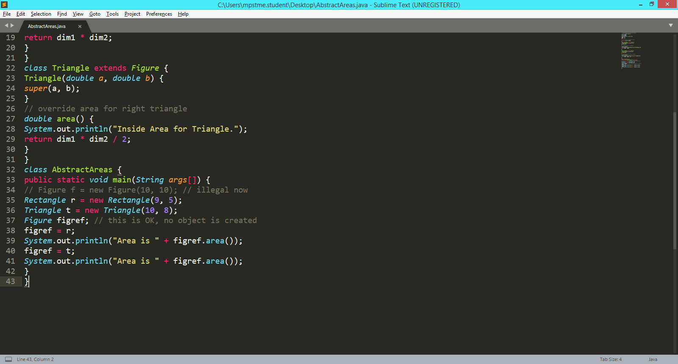
Abstract Example

Slide 62
final keyword

Slide 63
final to prevent variable modification
A field (variable) can be declared as final.
Doing so prevents its contents from being modified, making it, essentially, a constant.
We can initialize it in two ways:
First, you can give it a value when it is declared.
Assign it a value within a constructor.
Example:
final int FILE_NEW = 1;
final int FILE_OPEN = 2;
final int FILE_SAVE = 3;
final int FILE_SAVEAS = 4;
final int FILE_QUIT = 5;

Slide 64
final to prevent Overriding
When you want to prevent method overriding from occurring (to disallow a method from being overridden), specify final as a modifier at the start of its declaration.
Methods declared as final cannot be overridden
class A {
final void meth() {
System.out.println("This is a final method.");
}
}
class B extends A {
void meth() { // ERROR! Can't override.
System.out.println("Illegal!");
}
}

Slide 65
final to prevent Inheritance
To prevent a class from being inherited, precede the class declaration with final
Declaring a class as final implicitly declares all of its methods as final, too
final class A {
final void meth() {
System.out.println("This is a final method.");
}
}
class B extends A // Error

Slide 66
It is illegal to declare a class as both abstract and final since an abstract class is incomplete by itself and relies upon its subclasses to provide complete implementations.

Slide 67
Does Java support Multiple Inheritance?

Slide 68
interface

Slide 69
Interface definition
Using interface, you can specify what a class must do, but not how it does it.
Interfaces are syntactically similar to classes, but they lack instance variables and their methods are abstract (no body)
(When a class has all its member methods as abstract that class becomes an interface)

Slide 70
Interface definition
Once it is defined, any number of classes can implement an interface
Also, one class can implement any number of interfaces (multiple inheritance)
interface allows you to fully utilize the “one interface, multiple methods” aspect of polymorphism.

Slide 71
Defining an interface
access interface name {
return-type method-name1(parameter-list);
return-type method-name2(parameter-list);
type final-varname1 = value;
type final-varname2 = value;
//...
return-type method-nameN(parameter-list);
type final-varnameN = value;
}
interface Callback {
void callback(int param);
}

Slide 72
Implementing an Interface
To implement an interface, include the implements clause in a class definition, and then create the methods required by the interface.
class classname [extends superclass] [implements interface [,interface...]]
{
// class-body
}
Note: The methods that implement an interface must be declared public. Also, the type signature of the implementing method must match exactly the type signature specified in the interface (method overriding)

Slide 73
Implementing an Interface
class Client implements Callback {
// Implement Callback's interface
public void callback(int p) {
System.out.println("callback called with " + p);
}
void nonIfaceMeth() {
System.out.println("Classes that implement interfaces " +
"may also define other members, too.");
}
}
Note: Classes that implement interface can have their own methods as shown in the above program.

Slide 74
We can not create instances of an interface.
A reference of an interface can refer an object of a class which implements that interface.
Variables declared inside an interface are by default final.

Slide 75
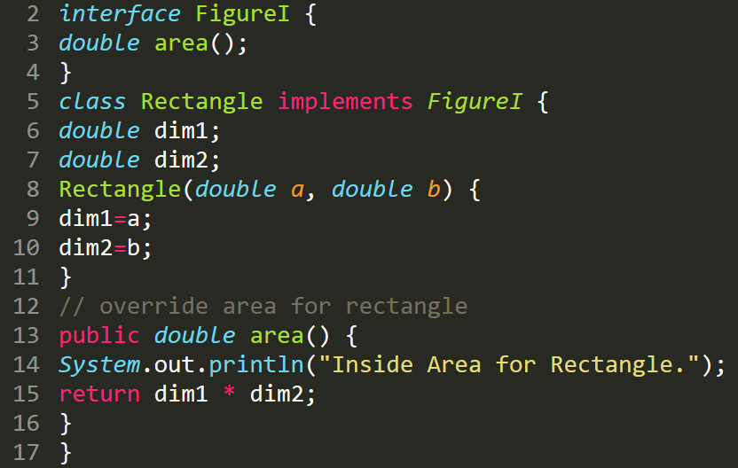
Interface real world example

Slide 76
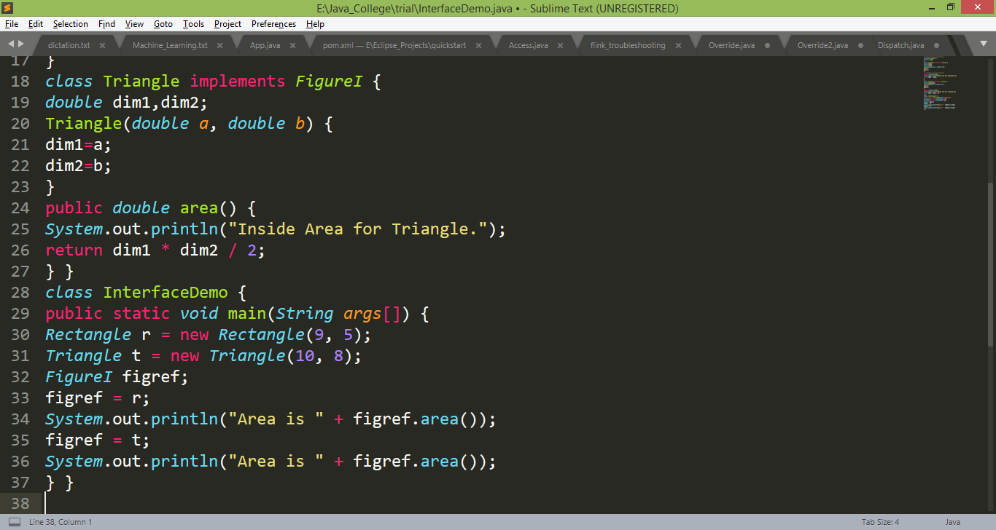
Interface real world example

Slide 77
Multiple Inheritance Exercise
Consider one interface Player having 3 methods i.e. start(), stop() and play_pause(). Create class which implements this interface and test the functionality of these methods.

Slide 78
Interface real world example
Consider an interface “StackIntf” having two member methods push() and pop().
Create a class MyStack which implements StackIntf and provides implementation logic of push() and pop() methods.
Write a Java program to demonstrate the functionality of Stack using MyStack class.

Slide 79
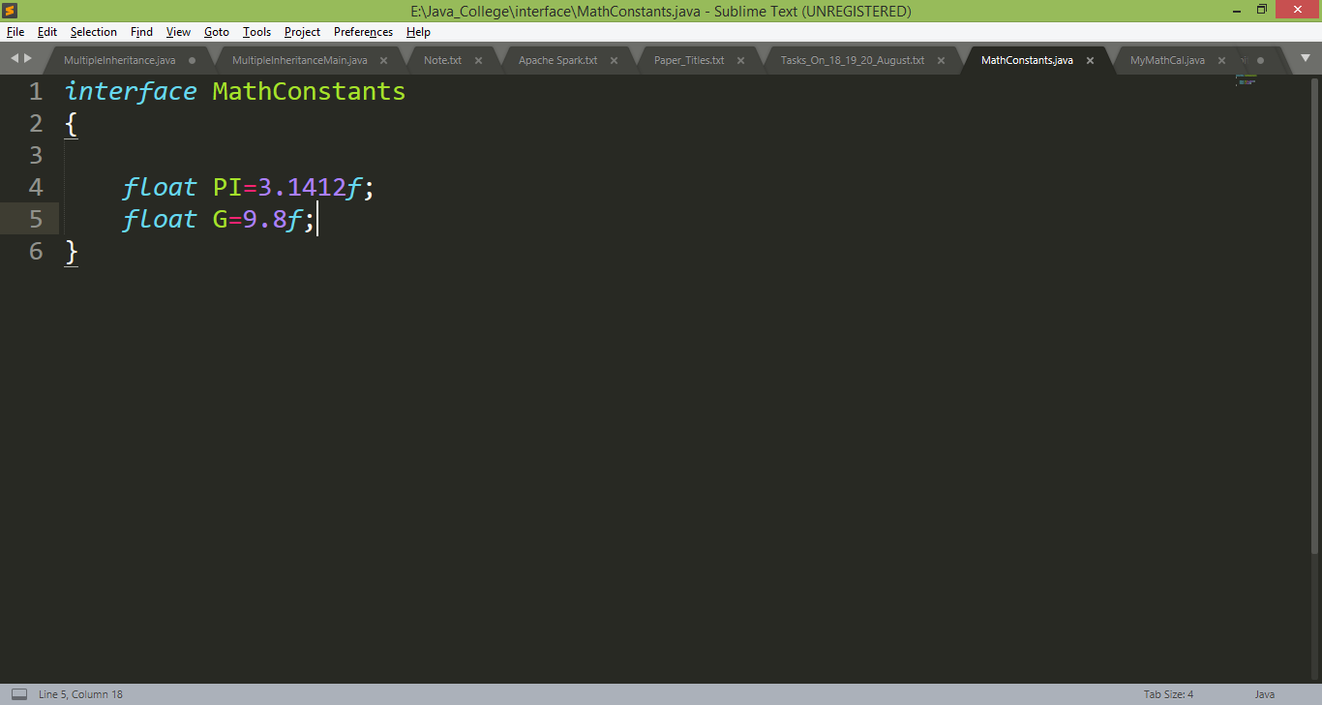
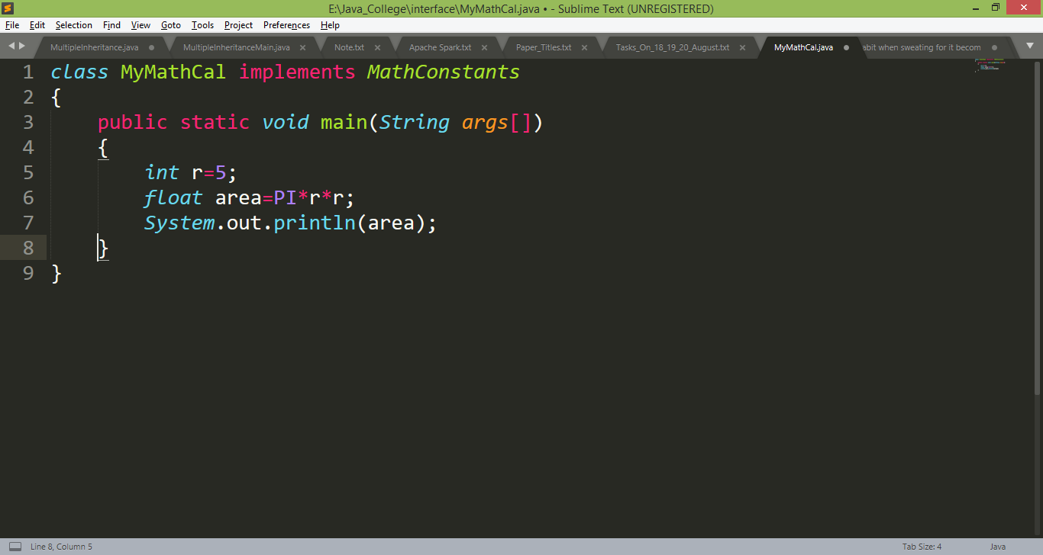
Interface of mathematical constants

Slide 80
Multiple Inheritance
Consider a class Figure having dim1 and dim2 as instance members and one abstract method area().
Class Rectangle inherits Figure and calculates area of the rectangle.
Another class named “CenteredRectangle” is having x and y as instance members (indicates center pixel) inherits Rectangle class
and implements “DrawableShape” interface (having one method draw() ). The draw() will display the center pixel of a CentredRectangle object.
Write a Java program to display area and centered pixel of a CentredRectangle object.

Slide 81
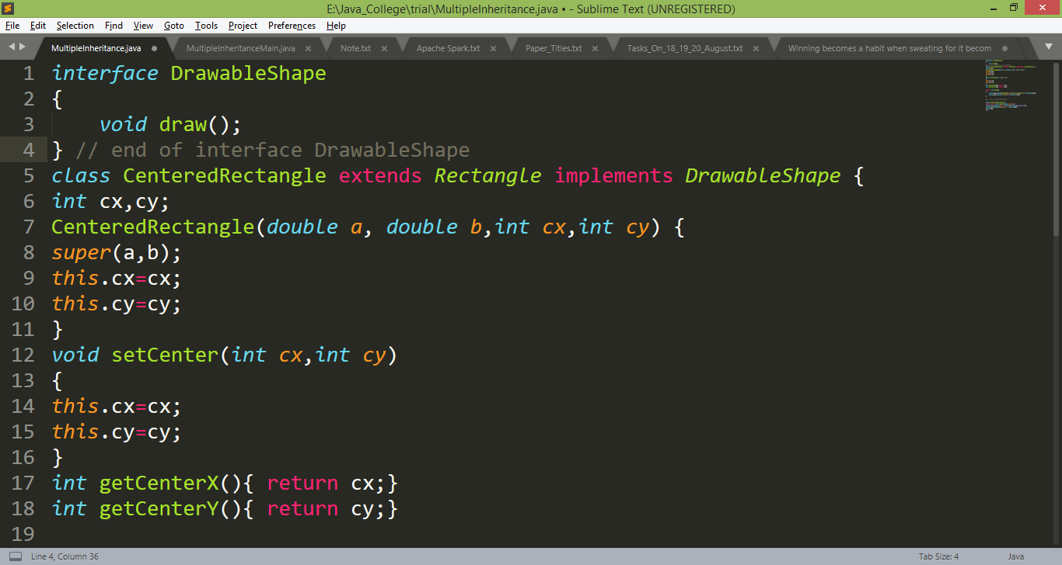
Multiple Inheritance

Slide 82
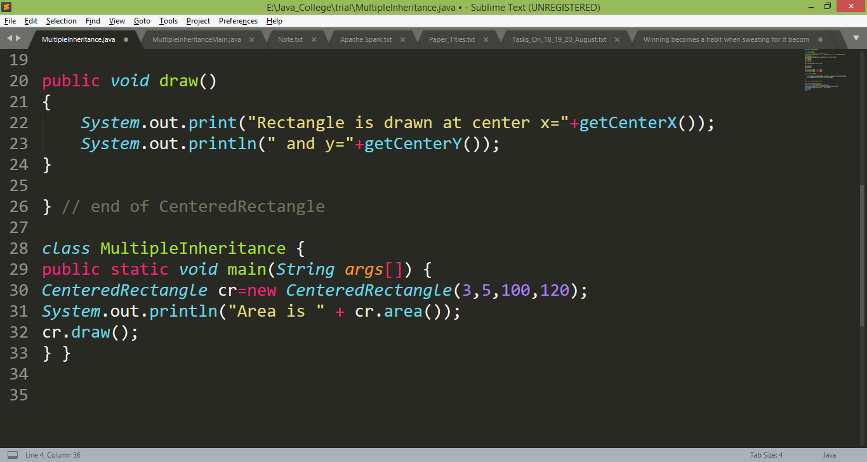
Multiple Inheritance

Slide 83
Multiple Inheritance Exercise
Consider a class named “Student” having id and name as instance members. A class “Test” inherits Student and having PT1 and PT2 as data members. There is one interface named “Sports” which contains a variable points assigned with value 5. (additional points of sports should be added in total marks of student who participated and won in sports activities in the semester)
Write a Java program to calculate the total marks of a student.

Slide 84
Interfaces can be extended
One interface can inherit another by use of the keyword extends
interface A {
void meth1();
void meth2();
}
interface B extends A {
void meth3();
}
// This class must implement all of A and B
class MyClass implements B {
public void meth1() {
System.out.println("Implement meth1().");
}

Slide 85
Interfaces can be extended
One interface can inherit another by use of the keyword extends
public void meth2() {
System.out.println("Implement meth2().");
}
public void meth3() {
System.out.println("Implement meth3().");
} }
class IFExtend {
public static void main(String arg[]) {
MyClass ob = new MyClass();
ob.meth1();
ob.meth2();
ob.meth3();
} }

Slide 86
Discussion
Difference between a concrete class, an abstract class and an interface. ?

Slide 87
Thanks!
Any questions?
You can find me at:
manish_ratilal2002@yahoo.com

Slide 88
Credits
Java The Complete Reference, Ninth Edition, Herbert Schildt

Slide 89
A ref_a;
B ref_b=new B();
ref_a=ref_b;

